Slide 1
Intermediate Code Generation - Types of Three address code, Representation, Declarations

Slide 2
Intermediate Code Generation
Facilitates retargeting: enables attaching a back end for the new machine to an existing front end
Enables machine-independent code optimization
Front end
Back end
Target machine code
Intermediate code

Slide 3
Intermediate Representations
Graphical representations
AST
Postfix notation: operations on values stored on operand stack
JVM bytecode
Three-address code: x := y op z
Variation of three address code - two-address code: x := op y

Slide 4
Syntax-Directed Translation of Abstract Syntax Trees
Production S → id := E E → E₁ + E₂ E → E₁ * E₂ E → - E₁ E → ( E₁ )
E → id
Semantic Rule S.nptr := mknode(‘:=’, mkleaf(id, id.entry), E.nptr) E.nptr := mknode(‘+’, E₁.nptr, E₂.nptr) E.nptr := mknode(‘*’, E₁.nptr, E₂.nptr) E.nptr := mknode(‘uminus’, E₁.nptr) E.nptr := E₁.nptr
E.nptr := mkleaf(id, id.entry)

Slide 5
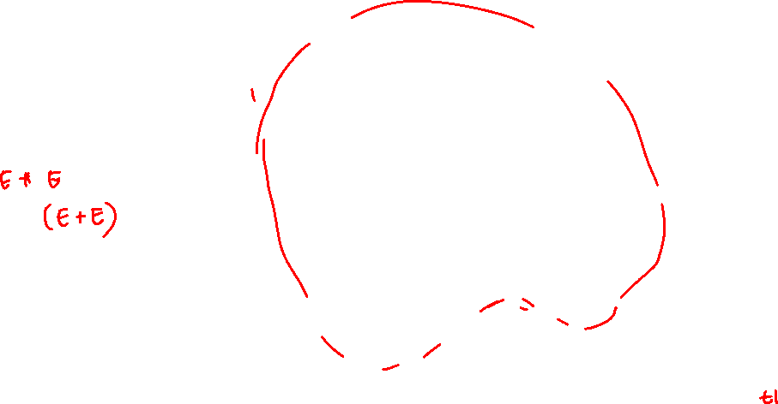
Abstract Syntax Trees
E.nptr
a * (b + c)
E.nptr
*
E.nptr
a
(
E.nptr
)
E.nptr
+
E.nptr
b
c
*
a
+
b
c

Slide 6
Abstract Syntax Trees versus DAGs
a := b * -c + b * -c
:=
:=
a
+
a
+
*
*
*
b
uminus
b
uminus
b
uminus
c
c
c
Tree
DAG

Slide 7
Postfix Notation
a := b * -c + b * -c
Bytecode (for example)
iload 2 // push b iload 3 // push c ineg // uminus imul // * iload 2 // push b iload 3 // push c ineg // uminus imul // * iadd // + istore 1 // store a
a b c uminus * b c uminus * + assign
Postfix notation represents
operations on a stack
Notes:
Pro: easy to generate
Cons: stack operations are more difficult to optimize

Slide 8
Three-Address Code
a := b * -c + b * -c
t1 := - c t2 := b * t1 t3 := - c t4 := b * t3 t5 := t2 + t4 a := t5
t1 := - c t2 := b * t1 t5 := t2 + t2 a := t5
Linearized representation of a syntax DAG
Linearized representation of a syntax tree

Slide 9
Three address code
In a three address code there is at most one operator at the right side of an instruction
Example:
+
t1 = b – c
t2 = a * t1
t3 = a + t2
t4 = t1 * d
t5 = t3 + t4
+
*
*
d
a
-
b
c

Slide 10
Types of three address codes
x := y op z
x := op y
x := y
goto L
if x goto L and if (false x) goto L1
if x relop y goto L
Notes:
Each

Slide 11
Types of three address code
Procedure calls using:
param x
call p, n
y := call p, n
return y
x := y[i] and x[i] := y
x := &y
x := *y and *x :=y

Slide 12
Example
do i = i+1; while (a[i] < v);
L: t1 = i + 1
i = t1
t2 = i * 8
t3 = a[t2]
if t3 < v goto L
100: t1 = i + 1
101: i = t1
102: t2 = i * 8
103: t3 = a[t2]
104: if t3 < v goto 100
Symbolic labels
Position numbers
Notes:
Two Translation examples

Slide 13
Representing three address codes
Quadruples
Has four fields: op, arg1, arg2 and result
The contents of arg1, arg2, and result are usually pointers to the symbol table entries for the names represented by these fields
Unary operators like x := -y do not use arg2
Operators like param use neither arg2 nor result
Conditional and unconditional jump put target label in result

Slide 14
Three address code
Example: a:= b * -c + b* -c
Quadruple
 | Op | Arg1 | Arg2 | result
(0) | uminus | c |  | t1
(1) | * | b | t1 | t2
(2) | uminus | c |  | t3
(3) | * | b | t3 | t4
(4) | + | t2 | t4 | t5
(5) | := | t5 |  | a
t1 : = -c
t2 := b * t1
t3 : = - c
t4 := b * t3
t5 := t2 + t4
a := t5
Notes:
For readability, we use actual identifiers like a, b, and c in the fields arg1, arg2, and result in Fig. , instead of pointers to their symbol-table entries.
Temporary names can either by entered into the symbol table like programmer-defined names, or they can be implemented as objects of a class Temp with its own methods.

Slide 15
Representing three address codes
Triples
To avoid entering temporary names into the symbol table, we can refer to a temporary value by the position of the statement that computes it
Has 3 fields: op, arg1, and arg2
arg1, and arg2 are either pointers to the symbol table (for programmer-defined names or constants) or pointers to the triple structure (for temporary values)
Parenthesized numbers represent pointers into the triple structure itself

Slide 16
Example
Example: a:= b * -c + b* -c
t1 : = -c
t2 := b * t1
t3 : = - c
t4 := b * t3
t5 := t2 + t4
a := t5
 | Op | Arg1 | Arg2
(0) | uminus | c
(1) | * | b | (0)
(2) | uminus | c
(3) | * | b | (2)
(4) | + | (1) | (3)
(5) | := | a | (4)

Slide 17
Triples for arrays – ternary operation
x [i] : = y
 | op | arg1 | arg2
(0) | []= | x | i
(1) | assign | (0) | y
x : = y [i]
 | op | arg1 | arg2
(0) | =[] | y | I
(1) | assign | x | (0)

Slide 18
Representing three address codes
Indirect triples
In addition to triples we use a list of pointers to triples
to list pointers to triples in the desired order
Notes:
Changing order of the instructions does not effect other instructions of result

Slide 19
Example
 | Statement
(30) | (0)
(31) | (1)
(32) | (2)
(33) | (3)
(34) | (4)
(35) | (5)
 | Op | Arg1 | Arg2
(0) | uminus | c
(1) | * | b | (0)
(2) | uminus | c
(3) | * | b | (2)
(4) | + | (1) | (3)
(5) | := | a | (4)

Slide 20
Comparison of Representations
Benefit of quadruples over triples can be seen in an optimizing compiler, where instructions are often moved around.
With quadruples, if we move an instruction that computes a temporary t, then the instructions that use t require no change.
With triples, the result of an operation is referred to by its position, so moving an instruction may require us to change all references to that result.
This problem does not occur with indirect triples, an optimizing compiler can move an instruction by reordering the instruction list, without affecting the triples themselves.

Slide 21
SDT into Three address code
Three address code is constructed based on the grammar construct
Non-terminals have Attributes
Code – sequence of three-address statements evaluating Expression
Place – Address/name that holds the value
Value

Slide 22
Three address code for expression
Production | Semantic Rules
S → id := E; | S.code = E.code || gen (top.get(id.lexeme) ‘:=‘ E.address
E → E1 + E2 | E.addr = new Temp() E.code = E1.code || E2.code || gen (E.addr ‘:=‘ E1.addr ‘+’ E2.addr)
E → - E1 | E.addr = new Temp() E.code = E1.code || gen (E.addr ‘:=‘ ‘uminus’ E1.addr)
E → (E1) | E.addr = E1. addr E.code = E1.code

Slide 23
Three address code
Production | Semantic Rules
E → E1 * E2 | E.addr = new Temp() E.code = E1.code || E2.code || gen (E.addr ‘:=‘ E1.addr ‘*’ E2.addr)
E → id | E.addr = top.get(id.lexeme) E.code = ‘ ‘

Slide 24
Example
a:= b + c * d
S → id := E => E + E => E +E * E = > id + id * id
The corresponding syntax tree would be

Slide 25
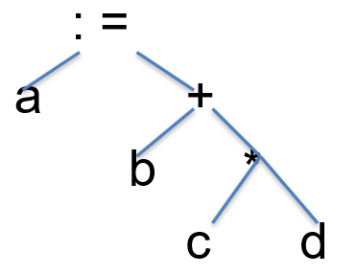

Example
* Node – New temp
E1.addr = c, E2.addr = d
+ Node – New temp
E1.addr = b, E2.addr=t1
t1 := c * d
t2 := b + t1
Root node
a := t2

Slide 26
Declarations – Three address code
Can be in a procedure – need to track scope of variable’s and need symbol table
Computing the address of variables and other is done by semantic rules related to three address code
Type, width, offset

Slide 27
Declarations
Production | Semantic rules
P → D | {offset = 0}
D → D ; D
D → id : T | {enter (id.name, T.type, offset); offset = offset + T.width;
T→ integer | T.type = integer; T.width = 4;
T → real | T.type = real; T.width = 8;
T→ array[num] of T1 | T.type = array(num.val, T1.type) T.width = num *T1.width;

Slide 28
Declarations
Production | Semantic rules
T → ↑ T1 | T.type = pointer (T1.type); T.width = 4;

Slide 29
Declarations
P → D
D → D ; D | id : T | proc id ; D ; S
A new symbol table is created when proc id; D;S is encountered

Slide 30
Symbol Table Functions
mktable(previous) creates a new symbol table and returns a pointer to the new table that is linked to a previous table in the outer scope. The pointer previous is placed in the header of the new symbol table.
enter(table, name, type, offset) creates a new entry for name in the symbol table pointed to by table
table – address of the current table, variable name, type and offset
addwidth(table, width) records the cumulative width of all entries in table in the header associated with this symbol table

Slide 31
Symbol Table functions
enterproc(table, name, newtable) creates a new entry in table for procedure name with local scope newtable
table – existing table, name of the newtable, address of the new table
lookup(table, name) returns a pointer to the entry in the table for name by following linked tables

Slide 32
Example
globals
struct S { int a; int b; } s; void swap(int a, int b) { int t; t = a; a = b; b = t; }
prev=nil
[4]
Trec S
s
(0)
[8]
prev=nil
swap
(0)
a
foo
(4)
b
Tfun swap
Tref
[12]
prev
Tint
(0)
a
(4)
b
(8)
t
Table nodes type nodes (offset) [width]
Tfun foo
[0]
prev

Slide 33
Example
void foo()
{ … swap(s.a, s.b); … }

Slide 34
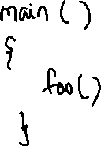
Example function call
Void foo( )
{ call A()
call B()
call (C)
}
Void A()
{
call D()
}

Slide 35
Calling stack
D
A
foo
Main
B
foo
Main
C
foo
Main
foo
Main

Slide 36
Symbol Table semantic rules
Productions | Semantic Rule
P → M D ; S | {addwidth (top(tblptr), top(offset); pop(tblptr); pop(offset)}
M → ε | { t := mktable(nil); push(t, tblptr); push(0, offset) }
D → id : T | { enter(top(tblptr), id.name, T.type, top(offset)); top(offset) := top(offset) + T.width }
D → proc id ; N D₁ ; S | { t := top(tblptr); addwidth(t, top(offset)); pop(tblptr); pop(offset); enterproc(top(tblptr), id.name, t) }

Slide 37
Symbol Table creation
Productions | Semantic Rule
N → ε | { t := mktable(top(tblptr)); push(t, tblptr); push(0, offset) }
D → D₁ ; D₂
T → integer | { T.type := ‘integer’; T.width := 4 }
T → real | { T.type := ‘real’; T.width := 8 }
T → array [ num ] of T₁ | { T.type := array(num.val, T₁.type); T.width := num.val * T₁.width }
T → ^ T₁ | { T.type := pointer(T₁.type); T.width := 4 }

Slide 38
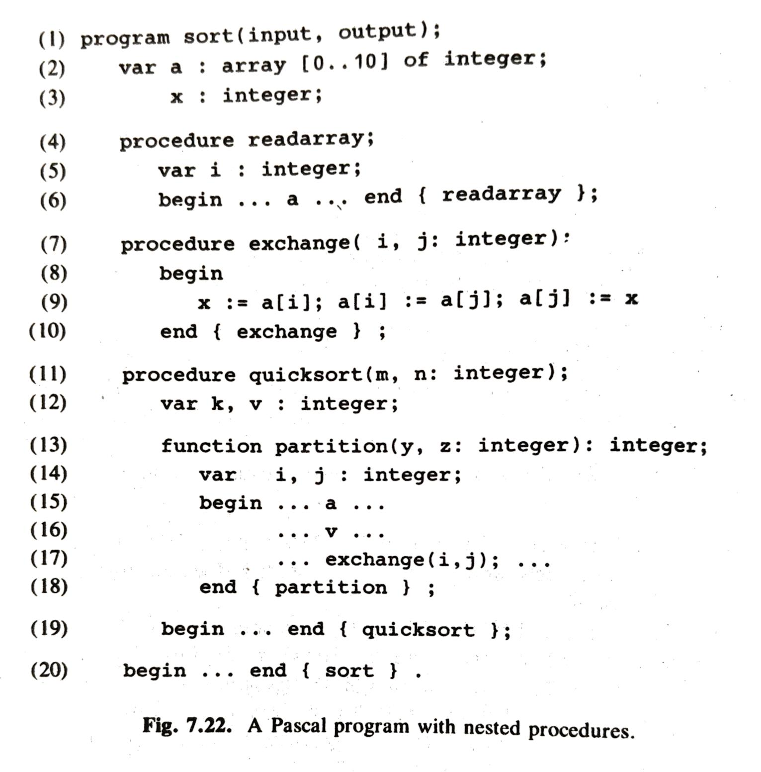

Slide 39
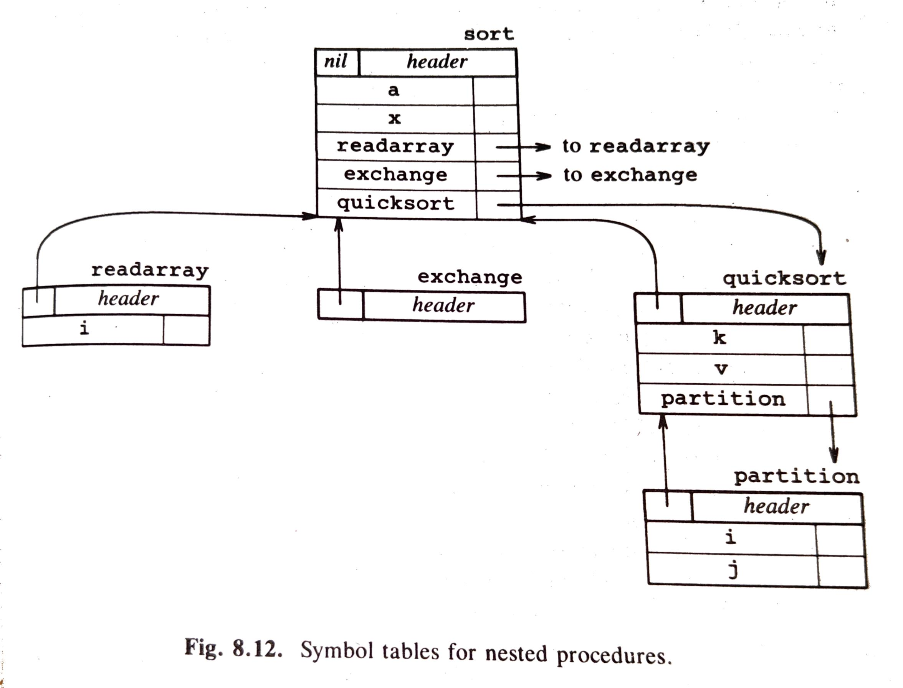

Slide 40
Symbol table tracking
Stack of tblptr is available to keep track of the available symbol table
When a new procedure is called a symbol table is created and its pointer pushed to this stack with offset
When the call terminates this tblptr is popped

Slide 41
Declarations and Records in Pascal
Production | Semantic rule
T → record L D end | { T.type := record(top(tblptr)); T.width := top(offset); addwidth(top(tblptr), top(offset)); pop(tblptr); pop(offset) }
L → ε | { t := mktable(nil); push(t, tblptr); push(0, offset) }

Slide 42
SDT’s of Statements
S → S ; S S → id := E { p := lookup(top(tblptr), id.name); if p = nil then error() else if p.level = 0 then // global variable emit(id.place ‘:=’ E.place) else // local variable in subroutine frame emit(fp[p.offset] ‘:=’ E.place) }

Slide 43
Assignment statements
Names in the symbol table
Variables referred to addresses
Lookup(id.name) identifies variable id in symbol table
Emit – used to emit three address statements to output file

Slide 44
Translation scheme
Production | Semantic Rules
S → id := E; | {p = lookup(id.name); If p ≠ nil then emit (p ‘:=‘ E.place) else error
E → E1 + E2 | {E.place= newtemp(); emit (E.place ‘:=‘ E1.place ‘+’ E2.place)}
E → E1*E2 | {E.place= newtemp(); emit (E.place ‘:=‘ E1.place ‘*’ E2.place)}
E → - E1 | {E. place = newtemp(); emit(E.place ‘:=‘ ‘uminus’ E1.place)}
E → (E1) | {E.place = E1. place}
E → id | {p := lookp(id.name); if p ≠ nil then E.place :=p else error}

Slide 45
Reusing Temporary Names
generate
E₁ + E₂
Evaluate E₁ into t1 Evaluate E₂ into t2
t3 := t1 + t2
If t1 no longer used, can reuse t1 instead of using new temp t3
Modify newtemp() to use a “stack”:
Keep a counter c, initialized to 0
newtemp() increments c and returns temporary $c Decrement counter on each use of a $i in a three-address statement

Slide 46
Reusing temporary name
x := a * b + c * d - e * f
Statement
c
0 1 2 1 2 1 0
$0 := a * b $1 := c * d $0 := $0 + $1 $1 := e * f $0 := $0 - $1 x := $0

